Slide 1

An analysis of variance in the fin ray counts of three populations of Dipterygonotus balteatus
Testing Jordan’s Rule
Ivan R. Lopez
Old Dominion University
Advisor: Kent E. Carpenter

Slide 2
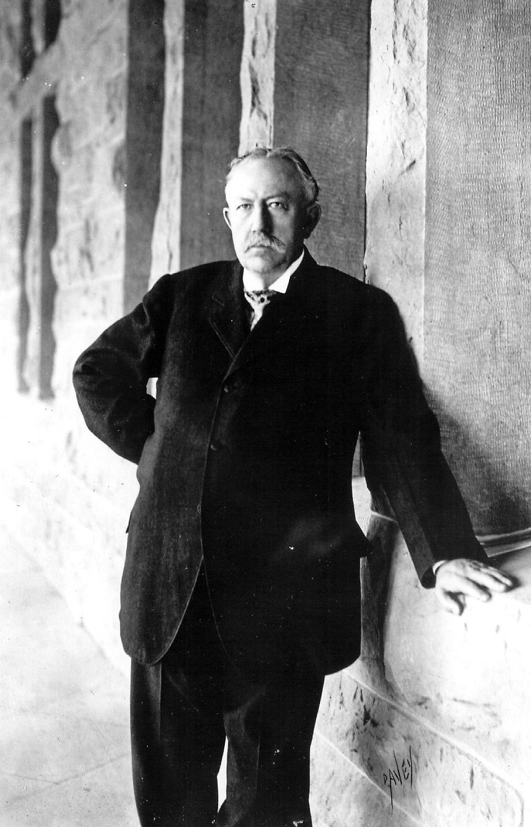
Introduction: Jordan’s Rule
David Starr Jordan (1851 – 1913)
Meristic counts increase with latitude
Meristics: the counting of quantitative features of fish

Slide 3
Is there a difference in the P1 ray counts of the populations from three different latitudes?
H_{A} = There are more P1 fin rays at higher latitudes.

Slide 4
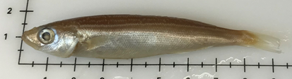
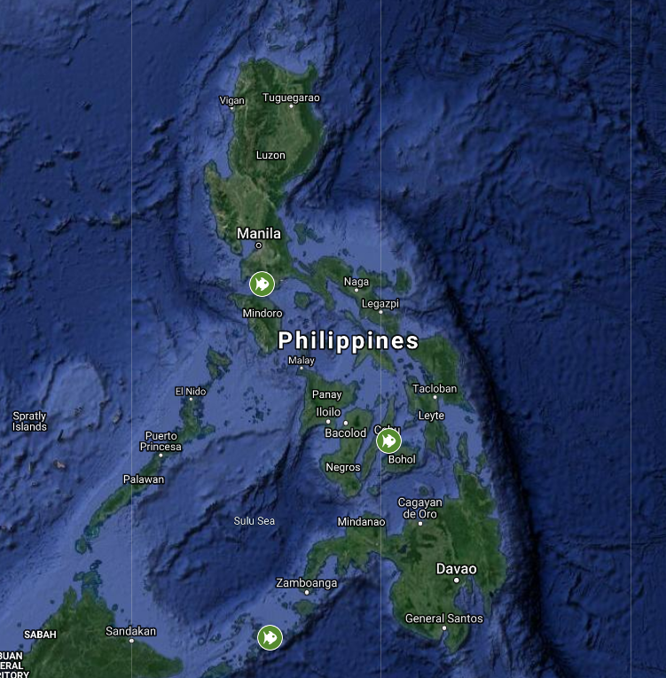
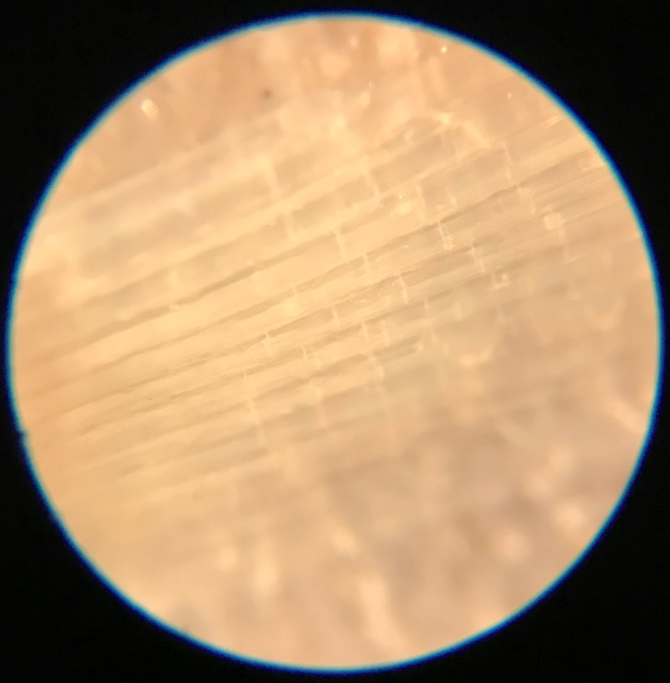
Experimental Design
13.95° N Batangas
10.32° N Cebu
5.91° N Jolo

Slide 5
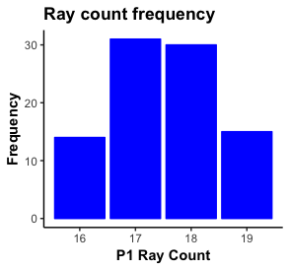
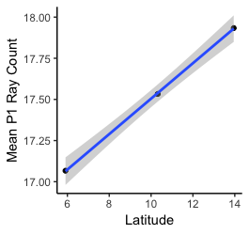
Results
F_{(2,87)}, p<0.05 = 7.096. P-value = 0.0014

